Slide 1
Mobile Application Development
Michael Brian Patterson

Slide 2





About Me
Graduated from BYU in Computer Science with emphasis in Animation
Married with 2 Kids
Love to Read, Love to Run, Love to Build
4 Years at Microsoft
Built a Dating App called Mutual

Slide 3
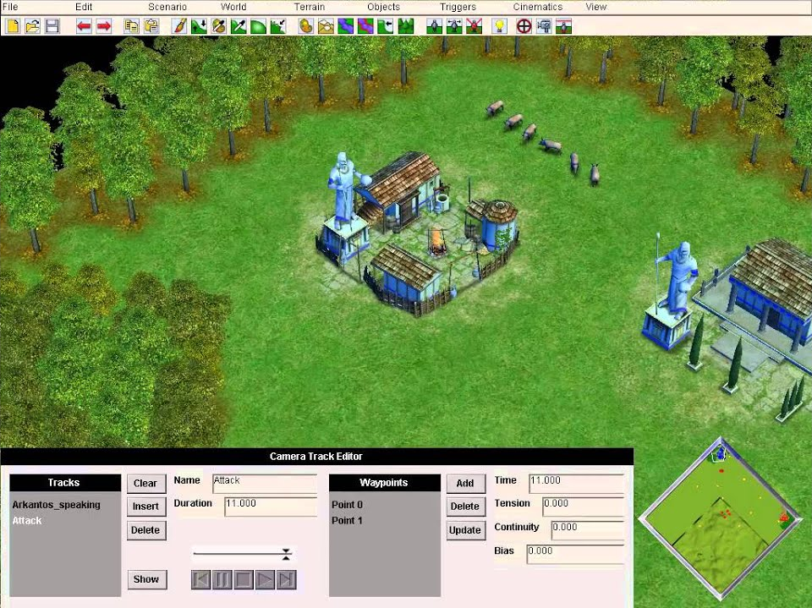
My journey into the land of coding…
Technology Classes
Multimedia Class in Middle School
Flash MX
Age of Mythology Editor
3D Modeling Class in High School
Hardware Class in High School
Graphic Design Class in High School
Computer Programming Class in High School
Flash Game Development

Slide 4
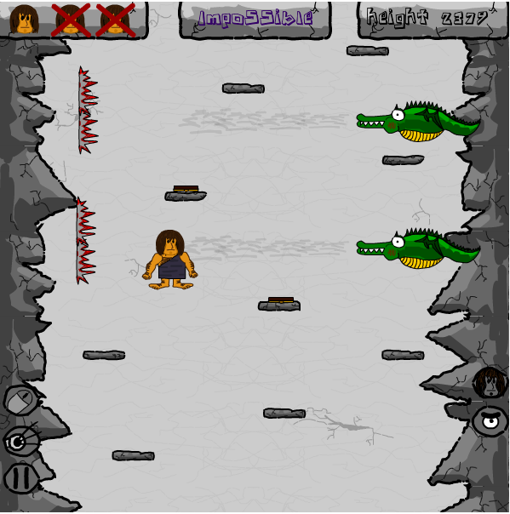
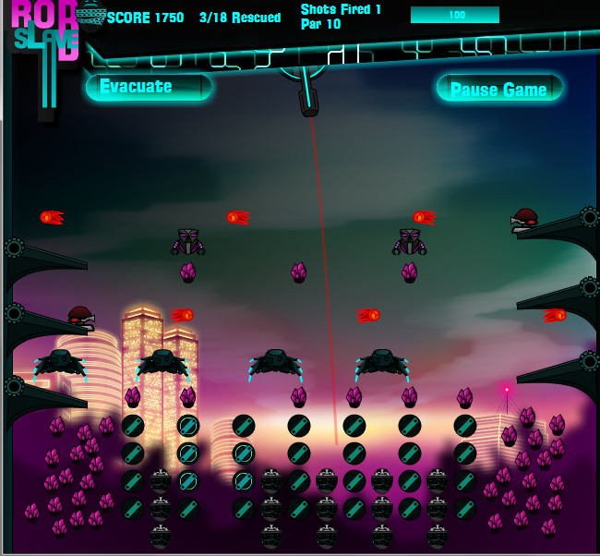
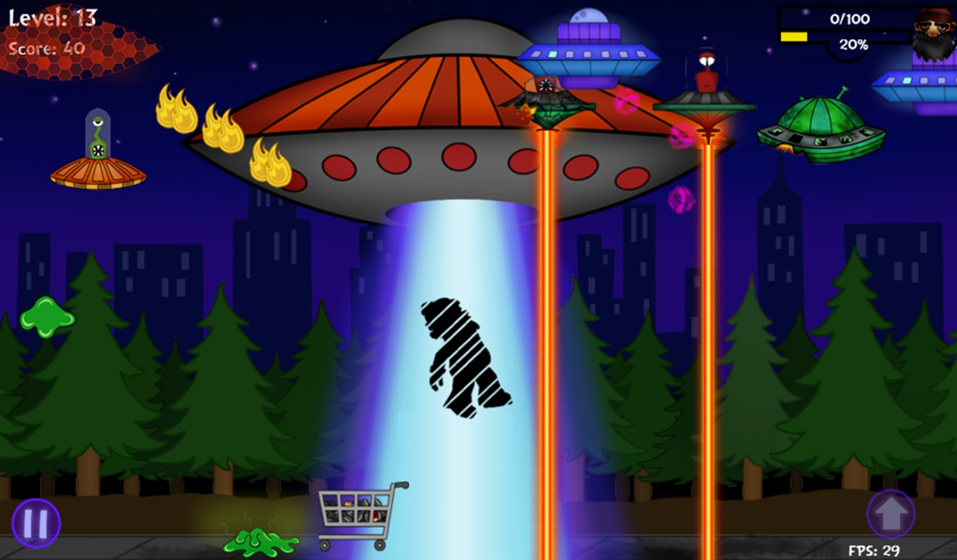
Games
Enigma Cave - $300
Enigma Space $250
RoboSlave - $500
Hobo vs Aliens - Unpublished

Slide 5
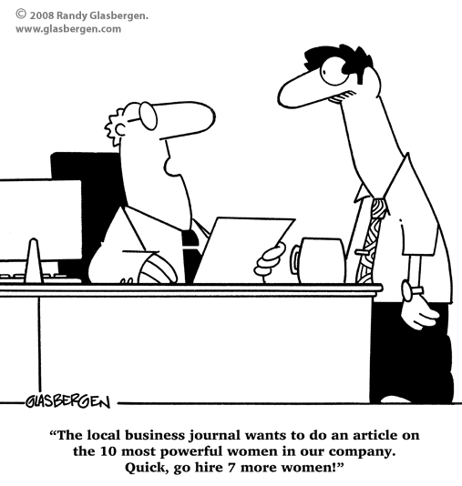
Why more women aren’t in tech?
Male dominated field
Other students might have a head start
Teachers often teach at the level of the students who already know the lesson.
Family Pressures. Can I have a family and work?
Don’t want to sit at a desk, or at a computer all day.

Slide 6

Why YOU should consider a tech career
Diversity + Inclusion. Shortage of Women = Amazing Opportunities for already in the field.
Average Salary of $108,900 compared to $53,040
Amazing Benefits!!!
Cool + Exciting Problems to work on.
Work life Balance.
Family Pressures. Can I have a family and work?
Part Time, Full Remote, Independent Contracting

Slide 7
Parental Leave
Local Company | Paid Leave Amount
Qualtrics | 4 weeks
Vivint | 12 weeks
Domo | 10 weeks (80% salary)
Pluralsight | Unlimited PTO
Ancestry | 12 weeks
Company | Paid Leave Amount
Netflix | 1 year
Microsoft | 20 weeks
Google | 18 weeks
Adobe | 26 weeks
Twitter | 20 weeks
Facebook | 18 weeks
Company | Paid Leave Amount
Intermountain Healthcare | 4 weeks
BYU | 6 weeks
Walmart | 6 weeks
Utah Teachers | 0 weeks
Most Jobs | 0-2 weeks
Mothers rooms
Flexible Hours
Work from Home

Slide 8
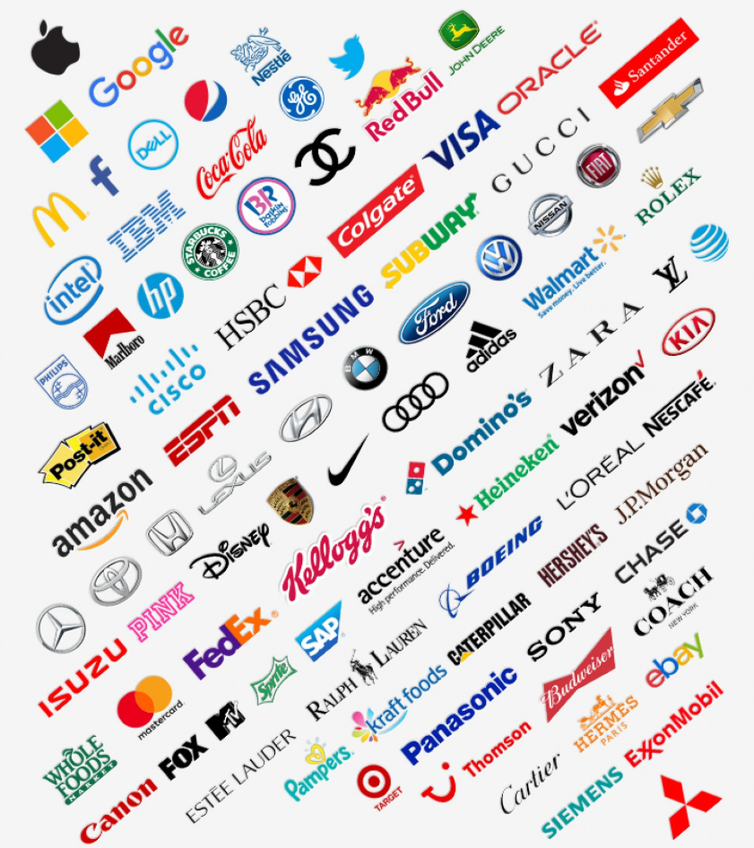
Every company is a tech company now…
There are technology related jobs at literally EVERY major brand and company in the world.

Slide 9
700,000

Slide 10
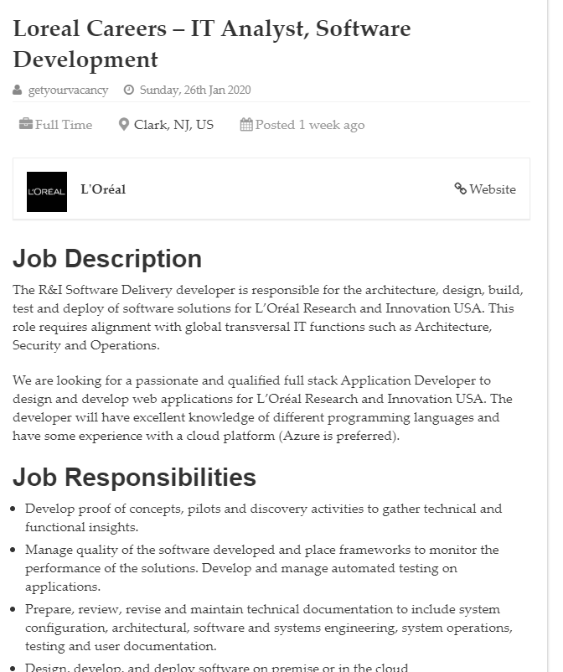
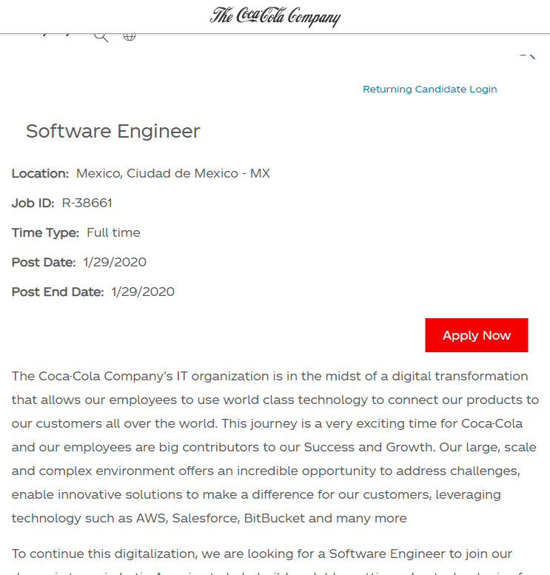

Slide 11
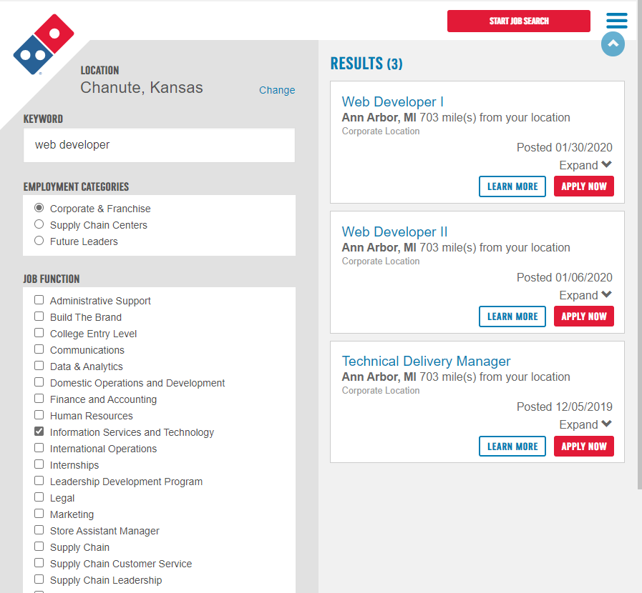
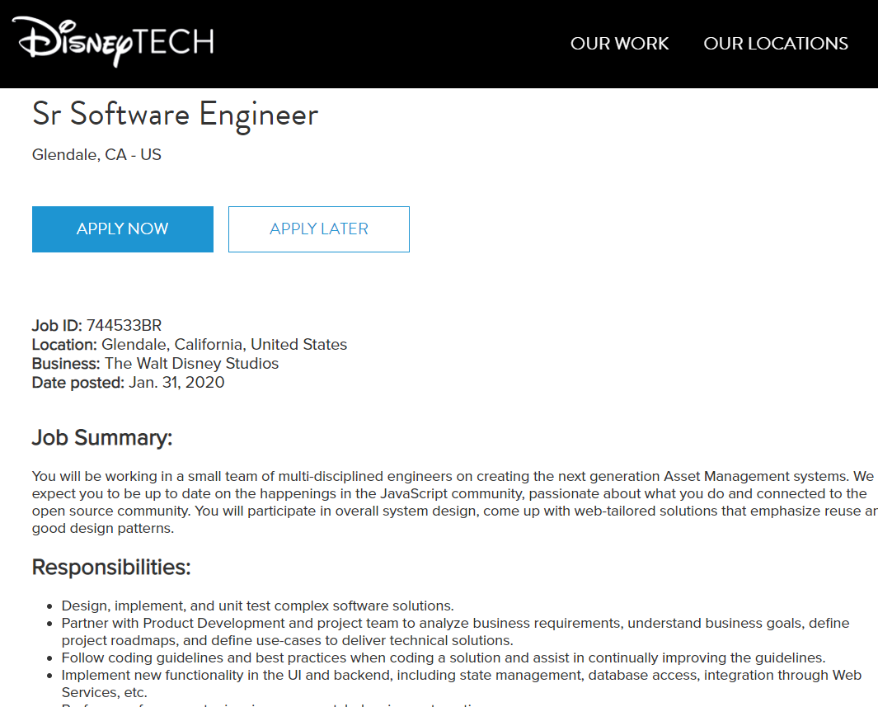

Slide 12
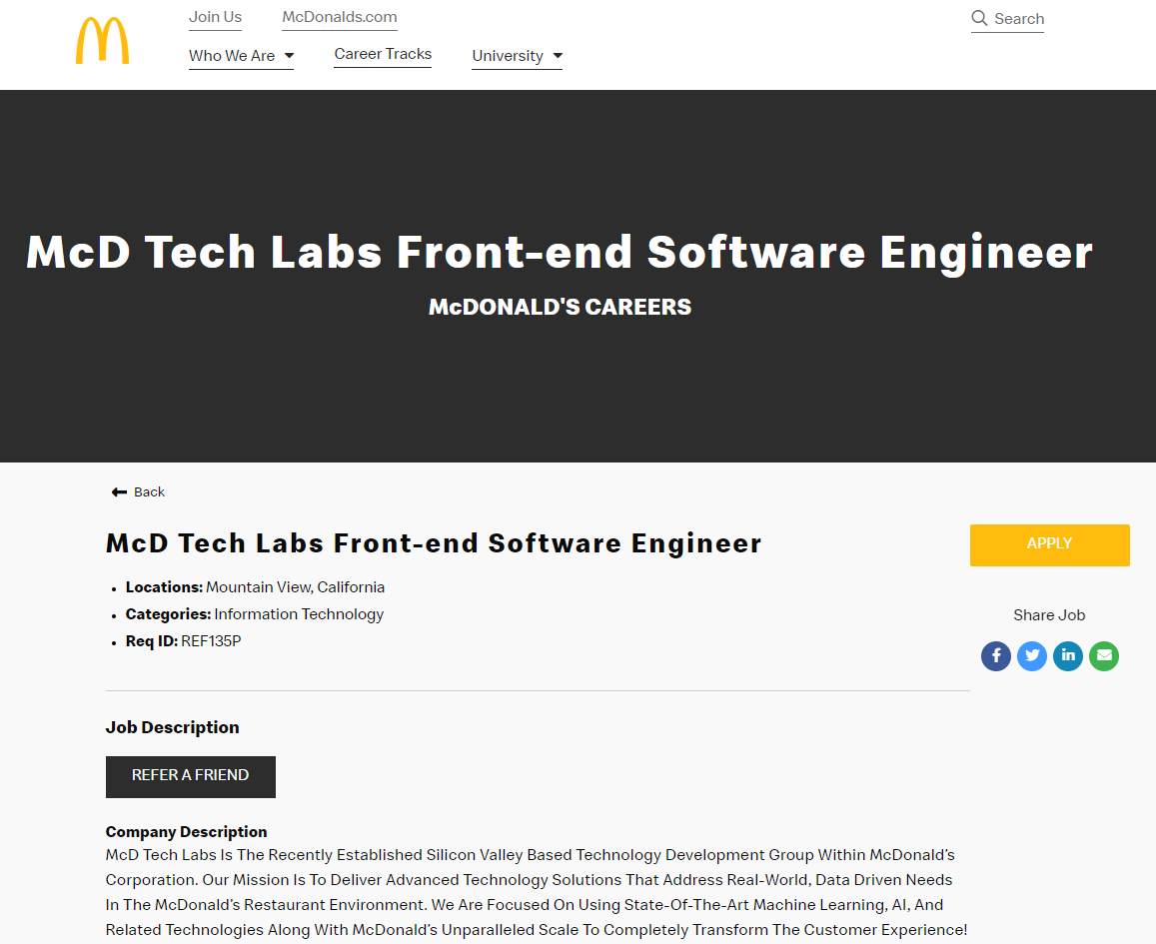
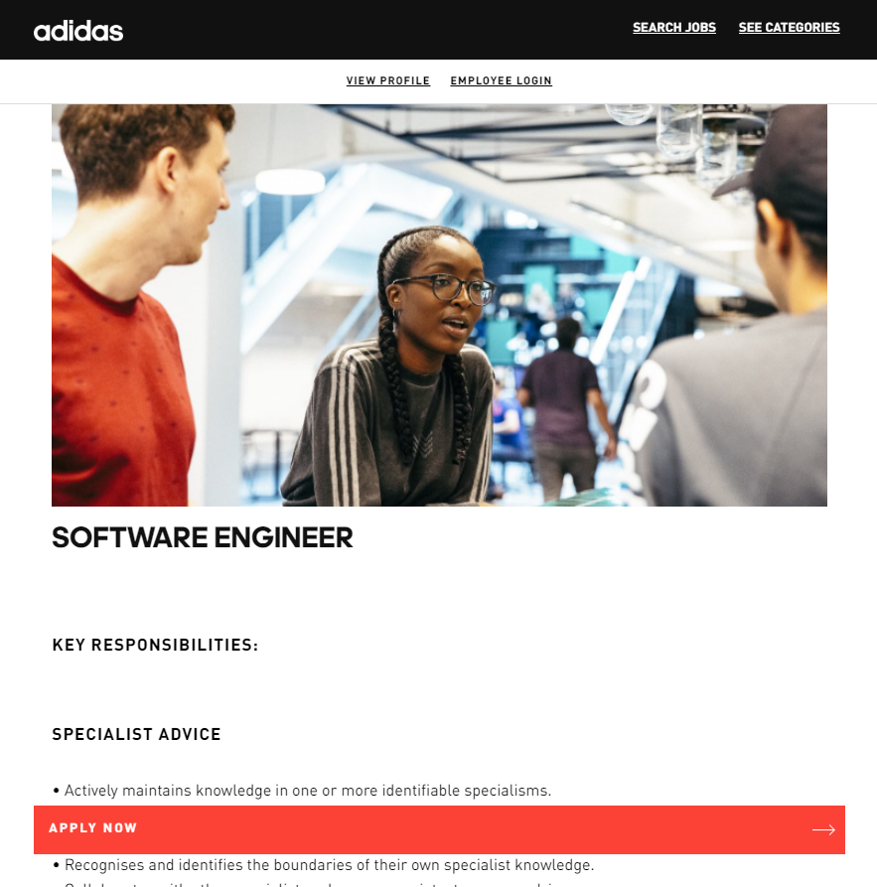

Slide 13
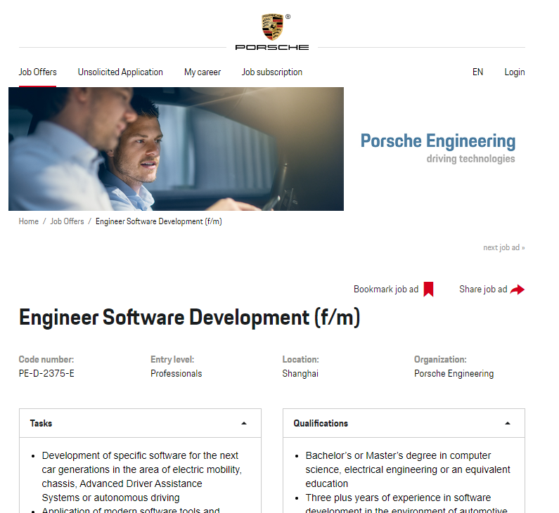
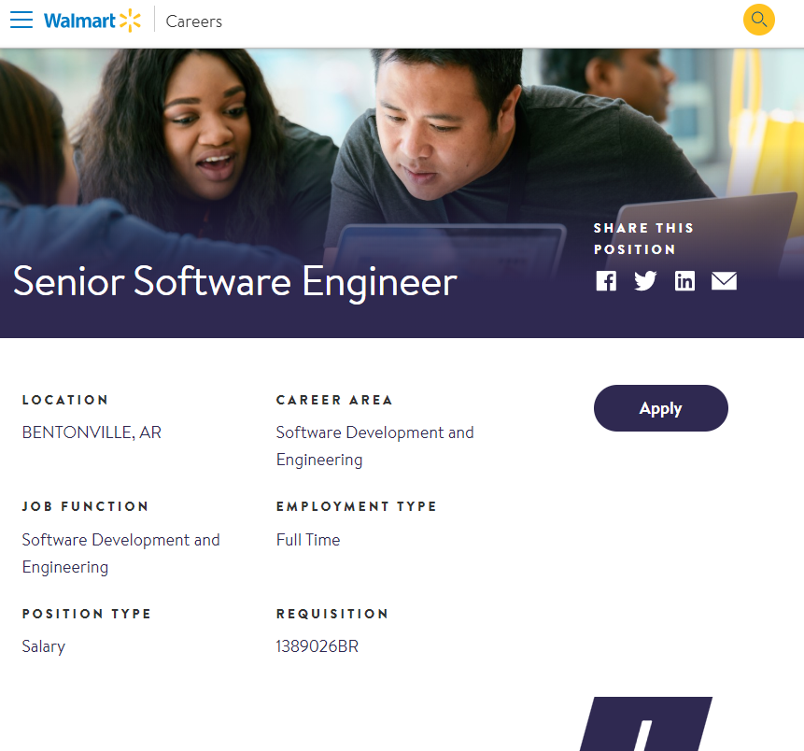

Slide 14
Game Lab
Lets make something!

